Slide 1
CHAPTER 8:
Secure Design and Threat Modeling
Lwomwa Joseph

Slide 2
Threat Modeling
Miriam Celi, CISSP ~ 2017 SFISSA Security Conference
To build secure software, we need to understand the risks
related to:
weaknesses in design, coding and integration
use cases and abuse cases
The goal of threat modeling is to identify potential risks or attacks that can occur to the system as it will be deployed, and to make decisions to address these risks in the design and development of the application.
A threat is an undesired event that may damage or compromise an asset or objective. It may or may not be malicious in nature.
An asset is a resource of value and can vary by perspective:
To the business, an asset might be the availability of information, or the information itself, such as customer data.
It might be intangible, such as a company's reputation.
To an attacker, an asset could be the ability to misuse your application for unauthorized access to data or privileged operations.

Slide 3
Threat Modeling
Miriam Celi, CISSP ~ 2017 SFISSA Security Conference
An outcome of the threat modeling activity is a threat model document that identifies:
Asset, actors, use cases
Relevant threats
Weaknesses that could be exploited
Countermeasures
Threat modeling is an iterative process. The threat model is a document that evolves and that various team members can work from.

Slide 4
Threat Modeling
Miriam Celi, CISSP ~ 2017 SFISSA Security Conference
What it is | What it’s not
A team activity | An activity performed by a single person.
A crucial activity in developing secure applications | An optional activity for developing secure application
An activity that helps identify vulnerabilities in software | A security audit
An activity started early in the design phase | An activity started late in the application life cycle
An iterative process that should be performed for every release, sprint, or iteration | An activity that is only performed once or once in a while

Slide 5
Benefits of Threat Modeling
Miriam Celi, CISSP ~ 2017 SFISSA Security Conference
Finding security bugs early
Improved understanding of security requirements
Engineer better products and services
Addresses security issues hidden in design
Develop secure by design solutions

Slide 6
Threat Modeling Participants
Miriam Celi, CISSP ~ 2017 SFISSA Security Conference
Threat modeling is a team activity
Members of development and test teams, such as:
Application architects
Security professionals
Developers
Testers
System Administrators
Work together to identify exposures in the application design of a system.

Slide 7
Threat Modeling Questions
Miriam Celi, CISSP ~ 2017 SFISSA Security Conference
It is important to identify:
what is being built? (the scope of the threat model)
what are the requirements?
what could go wrong? (abuse and exception cases)
possible bugs
what can be done to address the issues? (mitigation
techniques).

Slide 8
Threat Modeling Approaches
Miriam Celi, CISSP ~ 2017 SFISSA Security Conference
Software-centric
Focus is on software being built and what weaknesses and vulnerabilities are likely to be introduced in Design, Coding or Build Integration.
Asset-centric
Focus is on assets needing protection and entrusted to a system or software (data processed by the software) and what scenarios might compromise them or lead to non-compliance.
Attacker-centric
Focus is on profiling an attacker’s characteristics, skill-set, and motivation to exploit vulnerabilities and what scenarios might attackers use to compromise the application, system or service

Slide 9
Software-centric Approach
Miriam Celi, CISSP ~ 2017 SFISSA Security Conference
Questions to consider:
How is software designed and constructed?
What are the languages, components and runtimes used?
What are the relevant coding practices followed?
How is software built and integrated?
Involves the use of software architecture diagrams such as data-flow diagrams (DFD), use case diagrams, or component diagrams to identify threats to the design of the system.

Slide 10
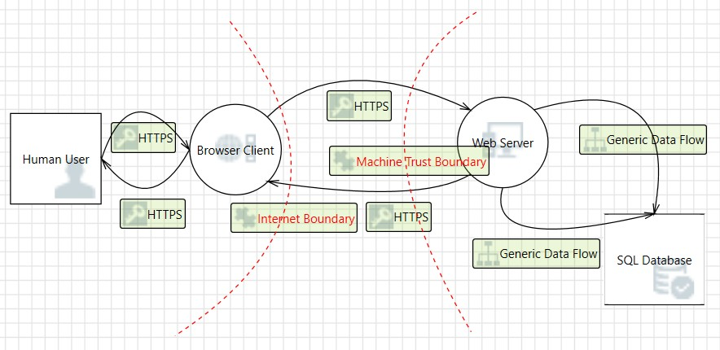
Data-Flow Diagram Example
Miriam Celi, CISSP ~ 2017 SFISSA Security Conference

Slide 11
Asset-centric Approach
Miriam Celi, CISSP ~ 2017 SFISSA Security Conference
Questions to consider:
What are the assets entrusted to the system or software?
What is the estimated value of those assets?
What are the consequences to compromise or loss of the assets?
How are those information assets protected?
Involves the use of attack trees or attack patterns by which an asset can
be attacked.

Slide 12
Attacker-centric Approach
Miriam Celi, CISSP ~ 2017 SFISSA Security Conference
Questions to consider:
Who is authorized and who is not?
What privileges do users have?
How is the software intended to be used?
How can the software be abused?
This approach also uses attack trees or attack patterns with focus on the specific goals of an attacker, how attacks could be carried out, and how to mitigate such attacks.

Slide 13
Which Approach to Use?
Miriam Celi, CISSP ~ 2017 SFISSA Security Conference
Software centric approach is best in exposing issues in the design of a
system because the focus is on the software being built.
Asset and Attacker centric approaches are important approaches to apply in threat modeling as well, but it’s best not to combine approaches to avoid confusion in the process.
A recommendation would be to start with the software centric approach for one release or sprint, and switch to a different approach for the next release or sprint.
Different approaches bring out different perspectives and different issues
to light.

Slide 14
1. Threat or Attack trees
Threat modeling using attack trees is another methodology used to model threats to software systems.
Attack trees/threat trees are conceptual diagrams showing how an asset, or target, might be attacked. Attack trees have been used in a variety of applications. In the field of information technology, they have been used to describe threats on computer system and possible attacks to realize those threats.
However, their use is not restricted to the analysis of conventional information systems. They are widely used in the fields of defense and aerospace for the analysis of threats against tamper resistant electronics systems (e.g., avionics on military aircraft). Attack trees are increasingly being applied to computer control systems (especially relating to the electric power grid. Attack trees have also been used to understand threats to physical systems.

Slide 15
Threat Modeling Process – Identify the Threats by Using Attack Trees
What are the conditions that allow the threat to take place (THREAT TREES)
Building threat trees is an effective method for determining computer system security issues. The idea behind threat trees is that an application is composed of threat targets and that each target could have vulnerabilities that when successfully attacked could compromise the system.
The threat tree describes the decision-making process an attacker would go through to compromise the software component.
The decomposition process has helped you to identify all the system components. You then identify potential threats to each component. Threat trees then help you decide how that threat could manifest itself.

Slide 16
Threat Modeling Process – Identify the Threats by Using Attack Trees cont’d
An attack tree and a threat tree are the same thing. In a traditional application threat model, you start with the component that you're building, (be that the entire application, a component or function, a data flow, etc.) and enumerate the potential threats to that component.
When you're building an attack tree, the development is reversed. You start with the attacker's end goal, and then enumerate the possible ways you could achieve the end goal, and only then look at the application to find locations where it may be vulnerable to the vectors you've identified.
Ideologically, attack trees are more a red-team style attacker-centric approach to the problem, which can provide useful additional insight.
Provide a methodical way of describing the security of systems, based on threats
Threats are ordered into a tree-­‐like structure
The root node of this tree represents the overall goal of an attacker
Intermediary nodes represent sub-­‐goals for the attacker to achieve in order to achieve the overall goal
The leaf nodes represent the diﬀerent ways or possible attacks how to achieve this goal

Slide 17
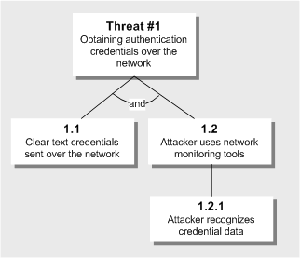
Attack Tree Example
Miriam Celi, CISSP ~ 2017 SFISSA Security Conference
Root node represents the goals of the attacker.
Leaf nodes represent the
unique attack methods.

Slide 18
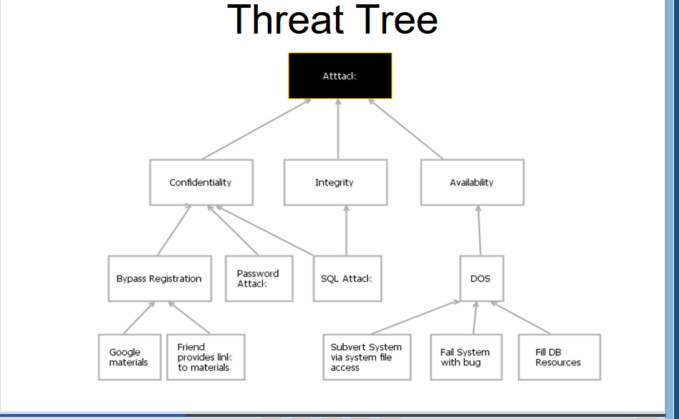
Threat Tree Example
<number>
From Security in Computing, Fifth Edition, by Charles P. Pfleeger, et al. (ISBN: 9780134085043). Copyright 2015 by Pearson Education, Inc. All rights reserved.

Slide 19
Threat Trees
Threat trees have two kinds of nodes:
OR nodes: represent alternative attacks
AND nodes: represent the need that all steps (attacks) have to be taken for achieving a higher-­‐ level goal
In the safe example:
AND node “eavesdrop”: attackers have to listen in to conversations and get safe owner to actually say the combination
After the tree is built different values can be assigned to the leaf nodes and these values are used to calculate the security of the goal.
These values are totally dependent on the security expert and system engineer. The assignment of values is a manual process.
The other attributes such as time required completing a step, operational expense, expertise required to launch an attack etc. can also be added to attack trees.

Slide 20
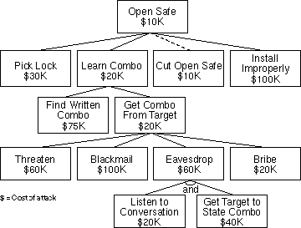
Threat Trees: Assigning Costs
A company can also analyse the possible costs of attacks:
OR nodes will be annotated by the cost of their cheapest child node
AND nodes will be annotated with the sum of the costs of all child nodes
Find cheapest attack and defend against it in particular

Slide 21
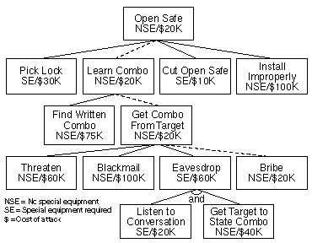
Threat Trees: Combine Annotations
E.g: “Find cheapest attack that requires no special equipment”

Slide 22
Creating a Threat Tree
Procedure:
Identify possible attack goals
Each of these goals is the starting point for a separate Threat Tree or a sub-­‐tree of a single Threat Tree
Identify possible attacks and sub-­‐goals to achieve a top-­‐ level goal, add concrete attacks as leaf nodes, add sub-­‐ goals to the tree
Repeat 2. for each added sub-­‐goal, until only leaf nodes (concrete attacks) are added to the tree
Assign annotations to each leaf node, propagate and aggregate annotations up the tree
Keep tree updated, if values are changed (company analyst changes values to ask “what-­‐if” questions)

Slide 23
Threat Modeling Process – Identify the Threats by Using Attack Trees
The way to write a threat tree is to identify goals and sub-goals of an attack, as well as what must be done so that the attack succeeds.
The threat tree on the next slide shows the ways in which an attacker could view another user’s confidential payroll data(this attacker’s end goal).
Although threat trees communicate data well, they can become cumbersome when building large threat models. An alternative way of representing the threat tree is using an outline, as illustrated on the slide.

Slide 24
Threat Modeling Process – Identify the Threats by Using Attack Trees EXAMPLE 2
1.0 View payroll data (I)
1.1 Traffic is unprotected (AND)
1.2 Attacker views traffic
1.2.1 Sniff traffic with protocol analyzer
1.2.2 Listen to router traffic
1.2.2.1 Router is unpatched (AND)
1.2.2.2 Compromise router
1.2.2.3 Guess router password
Threat #1 (I)
View payroll data
1.1
Traffic is
unprotected
1.2
Attacker views
traffic
1.2.1
Sniff traffic with
protocol analyzer
1.2.2
Listen to router
traffic
1.2.2.1
Router is
unpatched
1.2.2.2
Compromise
router
1.2.2.3
Guess router
password
Notes:
<number>

Slide 25
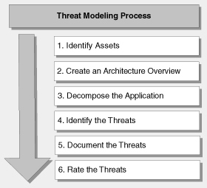
Threat Modeling Process
Miriam Celi, CISSP ~ 2017 SFISSA Security Conference
Threat modeling is an iterative process that should be repeated as the application evolves (for every release, sprint, or iteration)

Slide 26
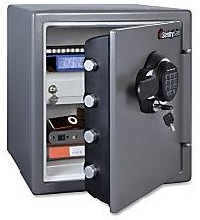
Step 1. Identify Assets
Miriam Celi, CISSP ~ 2017 SFISSA Security Conference
Identify the assets that need to be protected.
Assets are classified according to data sensitivity and their intrinsic value to a potential attacker.
Assets can range from confidential data, such as your customer or orders database, to web pages or web site availability.
Build a list of assets that require protection, including:
Confidential data, such as customer databases
Web pages
System availability
Anything else that, if compromised, would prevent correct operation of your application

Slide 27
Step 1: Identify Assets
<number>
Hardware: Processors, boards, keyboards, monitors, terminals, microcomputers, workstations, tape drives, printers, disks, disk drives, cables, connections, communications controllers, and communications media
Software: Source programs, object programs, purchased programs, in-house programs, utility programs, operating systems, systems programs (such as compilers), and maintenance diagnostic programs
Data: Data used during execution, stored data on various media, printed data, archival data, update logs, and audit records
People: Skilled staff needed to run the computing system or specific programs, as well as support personnel such as guards
Documentation: On programs, hardware, systems, administrative procedures, and the entire system
Supplies: Paper, forms, laser cartridges, recordable media, and printer ink, as well as power, heating and cooling, and necessary buildings or shelter
Reputation: Company image
Availability: Ability to do business, ability to resume business rapidly and efficiently after an incident
From Security in Computing, Fifth Edition, by Charles P. Pfleeger, et al. (ISBN: 9780134085043). Copyright 2015 by Pearson Education, Inc. All rights reserved.

Slide 28
Identifying an Asset in a System
ENTRY POINTS
Services
IIS, SQL, MSMQ, File, WS
Object or Classes
DLLs, Tables, Views, etc
Methods
Procedures, functions, Routines etc
ASSETS
Both concrete and abstract, that could be targets of an attack
A concrete example might be corporate data stored in a database.
A more abstract example might be network coherency in a peer to peer application.
Assets should be nouns.

Slide 29
Identifying an Asset in a System
USE SCENERIOS
Actor
User, Admin, Hacker, Someone
Interaction
Authenticates, Requests, Writes, Reads
Service
IIS, SQL, WS, etc.
EXTERNAL DEPENDENCIES
Feeds
Inbound (Pull) <implies trust>
Outbound (Push)
Feedstore vs. External Vendor?
Applications
Who consumes your service
Environments
Extranet vs. Intranet vs. Internet

Slide 30
Identifying an Asset in a System contd
Identify the trust boundaries that surround each of the assets in your application. For each subsystem, consider whether the upstream data flows, user input or calling code is trusted, and if not, consider how the data flows and input can be authenticated and authorized. Also consider server trust relationships.
Analyze the data flow between different subsystems, paying particular attention to data flows crossing trust boundaries and which roles have access to the data through the trust boundaries.

Slide 31
Identifying an Asset in a System and its subsystems
TRUST LEVELS
Trust levels characterize either entry points or assets.
Entry points describe the external entity that can interface with the entry point.
Assets indicate what privilege level would normally be able to access the resource.
The type of trust level is specific to the entry point or protected resource.
One should also be able to make sure all the different roles and identities acess the assets through the identified trust levels.
ROLES AND IDENTITIES
This allows the ability to define what roles exist in the application
Allow identification of what authentication mechanism is used
Also allow weighting of groups to assess impact and opportunity due to size of population

Slide 32
Identifying Subsystems cont’d
Carefully consider all entry points to your application – such as Web pages or socket servers – as these are potential routes for attack. Also consider entry points on internal subsystems or components. Although these entry points may only exist to allow internal communication between components in your application, they could also serve as points of attack, if the attacker manages to bypass the normal “front door” security controls.
Consider code that accesses secure resources such as DNS servers, directory services, environment variables, event logs, file systems, message queues, performance counters, printers, the registry, sockets, and Web services. Any code that demands special privileges or which works with the security system (for example .NET code access security) demands special vigilance. Consideration placing trust boundaries/levels at each entry point by using access code and special privileges.
Create a security profile for the application by documenting the design and implementation approaches for the application its self, input validation, authentication, authorization, configuration management, and the remaining areas where applications are most susceptible to vulnerabilities.

Slide 33



Step 2. Create an Architecture Overview
Miriam Celi, CISSP ~ 2017 SFISSA Security Conference
Identify what the application does (Use cases and misuse cases)
Create an architecture diagram
Identify the technologies used (helps to determine technology- specific threats).

Slide 34
Threat Modeling Process – Step 2: Create An Architecture Overview
Identify what the application does
Create an application architecture diagram
Identify the technologies
NTFS Permissions
(Authentication)
File Authorization
URL Authorization
.NET Roles
(Authentication)
User-Defined Role
(Authentication)
Trust Boundary
Trust Boundary
Alice
ASPNET
(Process Identity)
Mary
IIS
Microsoft
ASP.NET
Microsoft
SQL Server™
Bob
IPSec
(Private/Integrity)
SSL
(Privacy/Integrity)
Anonymous
Authentication
Forms
Authentication
Microsoft Windows
Authentication
Notes:
<number>

Slide 35
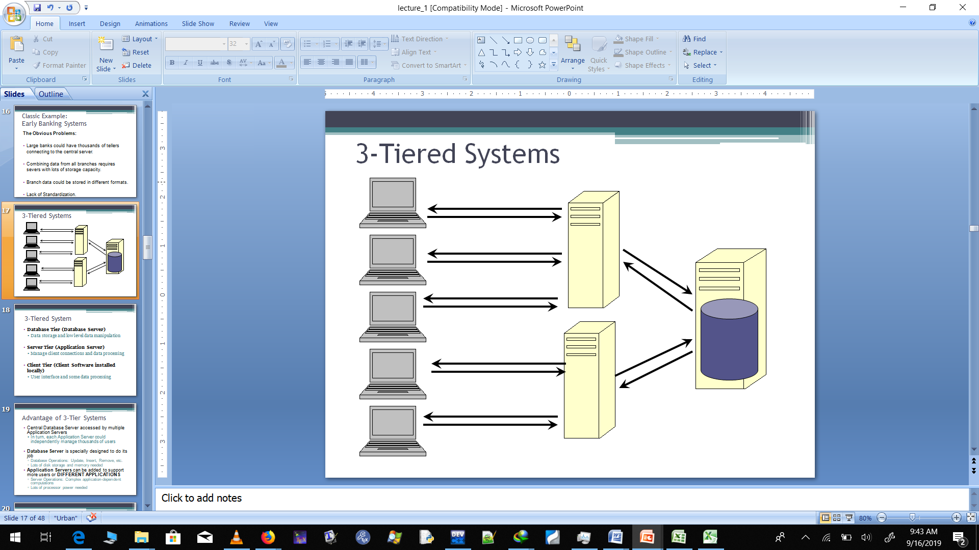
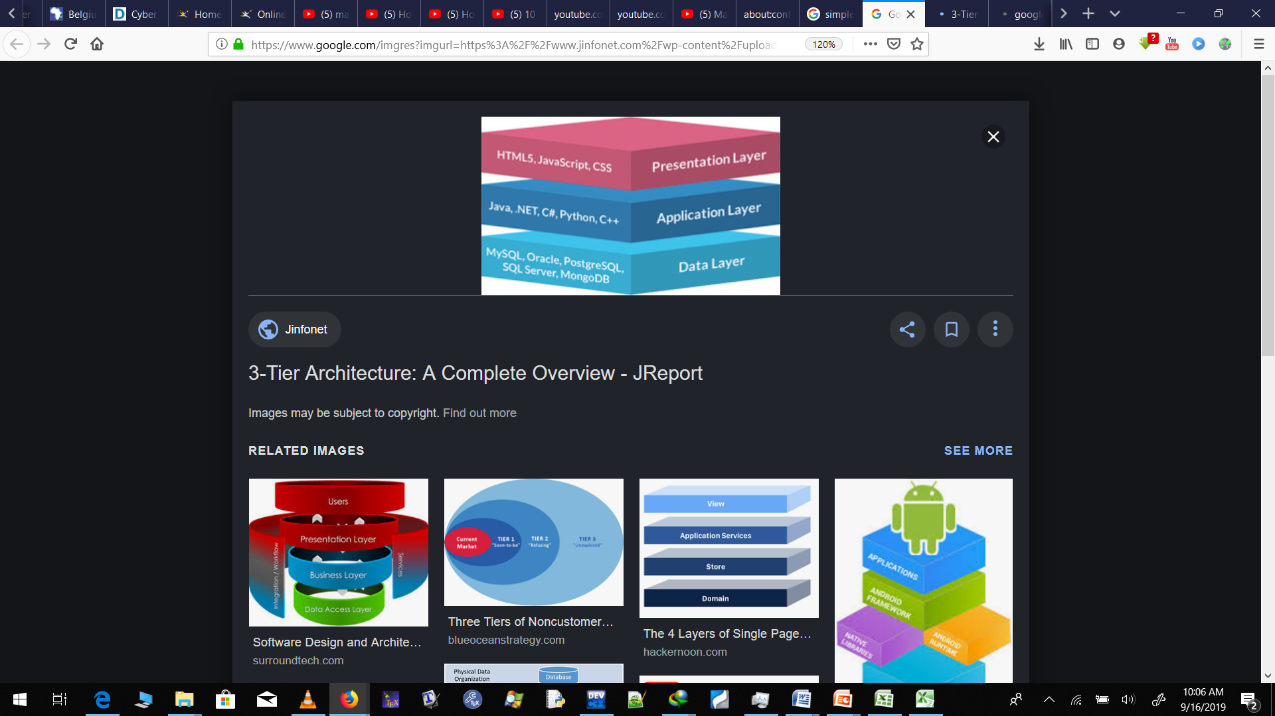
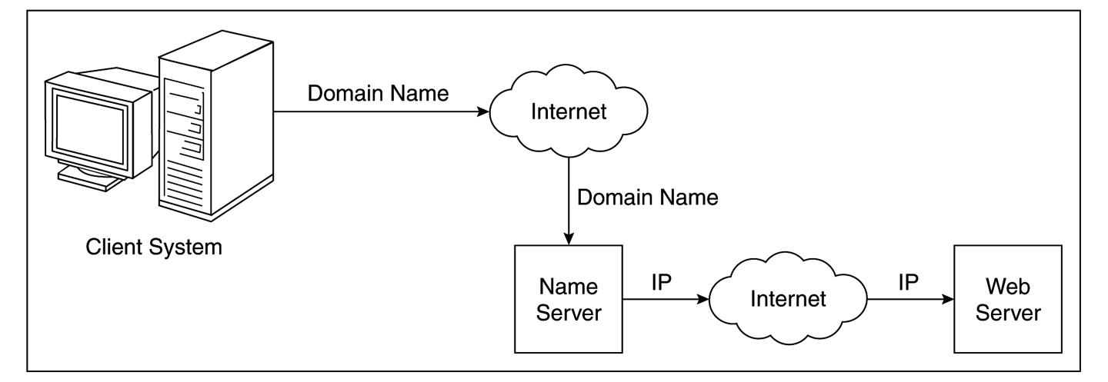
Three tier Architectural overview

Slide 36
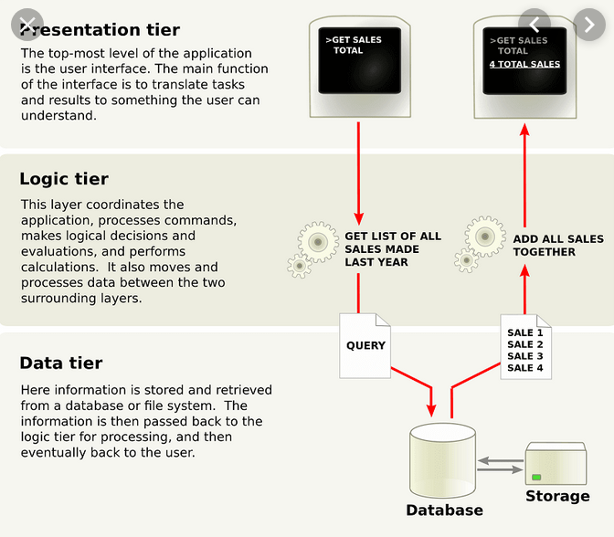

Slide 37
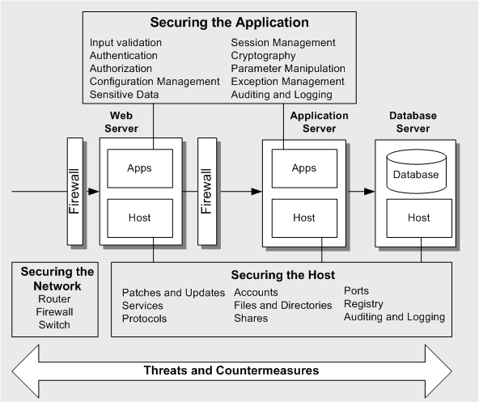
Architectual overview of the Threat Profile —Threats and Countermeasures

Slide 38
Create An Architecture Overview contd
The purpose of the architecture overview is to document the
function of your application,
its architecture and physical deployment configuration, and the technologies that form part of your solution.
There are three main parts to the application Architectural overview:
Identify what the application does. Document use cases to help you and others understand how your application is supposed to be used. This also helps you determine how it can be misused. Use cases put application functionality in context.
Create an architecture diagram. This describes the composition and structure of your application and its subsystems as well as its physical deployment characteristics. Depending on the complexity of the application, this may need to split into several diagrams that focus on specific areas
Identify the technologies. This helps you focus on technology-specific threats later in the process. It also helps you determine the correct and most appropriate mitigation techniques.

Slide 39
Step 3. Decompose the Application
Miriam Celi, CISSP ~ 2017 SFISSA Security Conference
Identify trust boundaries (surrounding the assets)
Identify data flow (Data flow across trust boundaries is particularly important)
Identify entry points (also serve as entry points for attacks)
Identify privileged code (accesses specific types of secure resources
and performs other privileged operations)
Document the security profile (helps to uncover vulnerabilities in the design, implementation, or deployment configuration of your application).

Slide 40
Threat Modeling Process – Step 3: Decompose the Application
Break down the application
Create a security profile based on traditional areas of vulnerability
Examine interactions between different subsystems
Use DFD or UML diagrams
Identify Trust Boundaries
Identify Data Flow
Identify Entry Points
Identify Privileged Code
Document Security Profile
Notes:
<number>

Slide 41
Decomposition (Cont’d)
DATA FLOW / DECOMPISITION
Time to break down the application
During initial design we don’t know much detail so we typically only go to the service level and partially identify ‘logical’ objects
We record this decomposition as “Entry Points”; components where an entity interfaces within the application
Data flow diagrams (DFDs) are a useful tool for decomposing an application into its key components. They provide the basis of a good technique for illustrating the flow of data between processes.
An alternative is UML activity diagrams, which are similar in purpose, although focus more on the transfer of control between processes. The guiding principle for DFDs is that an application or a system can be decomposed into subsystems, and subsystems can be decomposed into still lower-level subsystems.
Ignore the inner workings of the application, but focus on the scope of the application, not functional details. Decompose the application down only two, three or four levels deep – just deep enough to understand the threats to the application. Do not fail in the threat modeling process by analyzing too deeply and losing sight of the original objective.

Slide 42

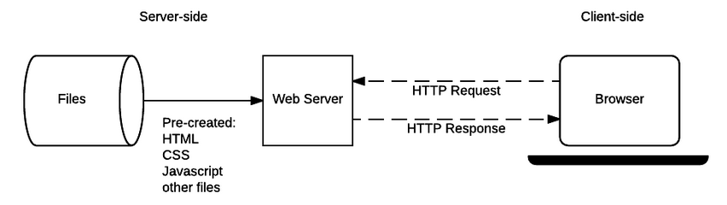
IIS6 Context Diagram
Notes:
<number>

Slide 43
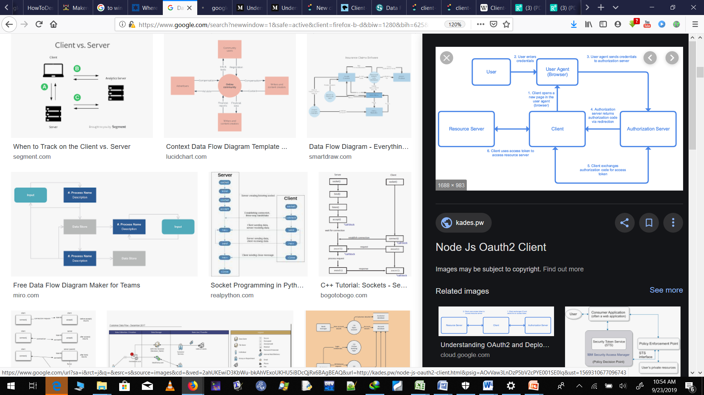
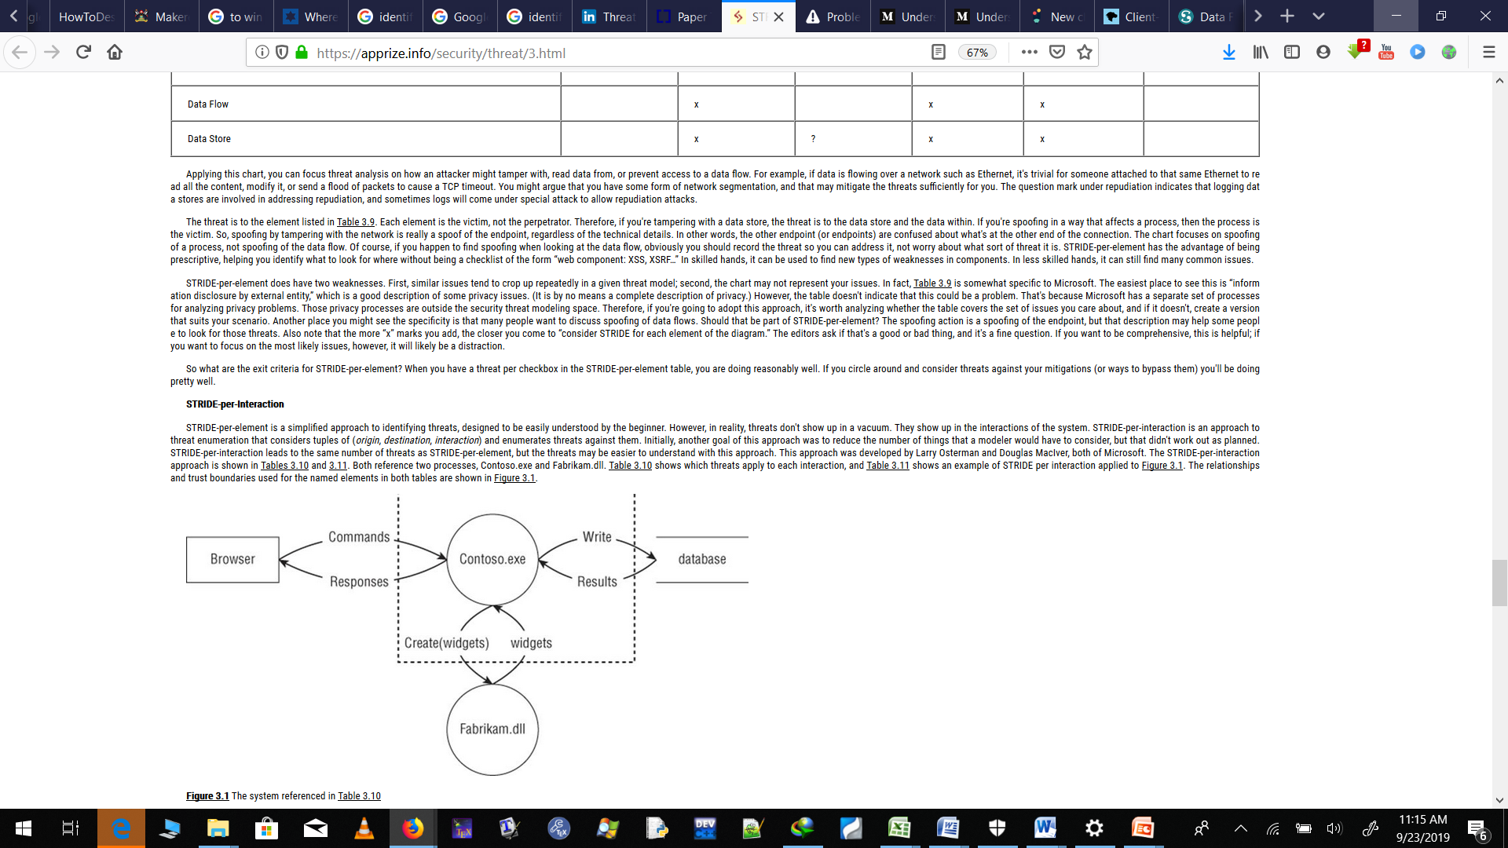

Slide 44
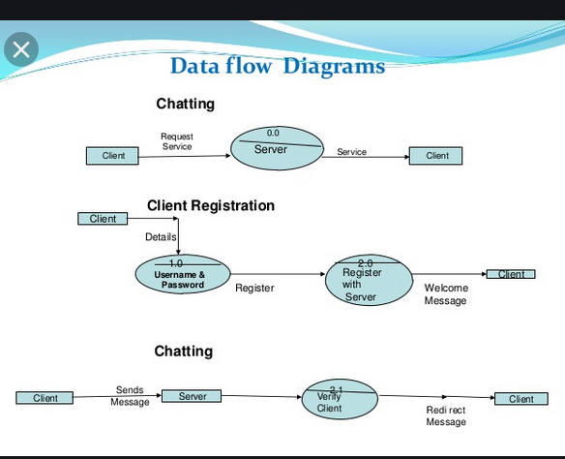

Slide 45

Step 4. Identify the Threats
Miriam Celi, CISSP ~ 2017 SFISSA Security Conference
In this stage of the threat modeling process, you identify threats to your system assets. The best way to do this is to assemble a team consisting of members of the development and test teams to conduct an informed brainstorming session in front of a whiteboard.
Identify the threats that could affect the application (keep goals of the attacker, architecture and potential vulnerabilities in mind):
network threats
host threats
application threats
Assemble team
The STRIDE threat classification methodology can be used to identify threats.

Slide 46
STRIDE – Threat Classification Methodology
Miriam Celi, CISSP ~ 2017 SFISSA Security Conference
Category | Threat Template
Spoofing | Threat action aimed to illegally access and use another user's credentials, such as username and password.
Tampering | Threat action aimed to maliciously change/modify persistent data, such as persistent data in a database, and the alteration of data in transit between two computers over an open network, such as the Internet.
Repudiation | Threat action aimed to perform illegal operations in a system that lacks the ability to trace the prohibited operations.
Information Disclosure | Threat action to read a file that one was not granted access to, or to read data in transit.
Denial of Service | Threat aimed to deny access to valid users, such as by making a web server temporarily unavailable or unusable.
Elevation of Privilege | Threat aimed to gain privileged access to resources for gaining unauthorized access to information or to compromise a system.

Slide 47
Defining the System in order to identify the threats (Cont’d)
EXTERNAL SECURITY NOTES
What do external entities need to be aware of in the context of security with regards to your application?
Who depends on your application?
Can they trust your outbound feed(s)?
Who do they need to contact re: security?
INTERNAL SECURITY NOTES
Are both host and application based threats.
Document security strategy notes
Priorities
Challenges
Exceptions
Constraints
IMPLEMENTATION
ASSUMPTIONS
Platform
W2K vs. W2K3 vs. ???
Technologies
SQL 2000 vs. ???
Protocols
SSL vs. IPSec
Standards
Known mitigating factors from Design Time

Slide 48
Identify the Threats cont’d
A threat is a possible harm that may occur due to vulnerability present in the design of software applications. When vulnerability in the design of systems is exploited, threat is materialized and attack happens. So, first step is making secure software applications is to identify all possible threats to the system. For this purpose, a threat modelling technique is applied.
Threat modeling is a technique that makes software systems more secure by including security measures into the design of software systems. Threat modeling is performed at the early stages of software development process with the purpose to identify all possible threats that may cause harm to the software applications.

Slide 49
Identify the Threats cont’d
There are three types of threats that you need to identify. You need to:
Identify network threats: Analyze the network topologies and look for vulnerabilities. Ensure your network is not vulnerable to incorrect device and server configuration.
Identify host threats: Look for vulnerabilities through poor configuration of hosts security. Consider patch levels and updates, services, protocols, accounts, files and directories, shares, ports, and auditing and logging.
Identify application/algorithm threats: Scrutinize the security profile you created in the previous stage of the threat modeling process. Focus on application threats, technology-specific threats, and code/algorithm threats. Look for things such as poor input validation, passing authentication credentials over unencrypted network connections, or using weak password or account policies.

Slide 50
THREAT MODELLING APPROACHES
Threat modeling helps to identify all possible threats along with different mitigation techniques. Many threat modeling approaches had been developed ranging from textual descriptions to graphical notations along with some tool support.
Threat modeling is a key element to integrate security into software systems. It enables us to identify critical areas of design which needs to be protected. Over the time various threat modeling approaches and methodologies have been developed and are being used in the process of designing secure web applications.
This approach varies from conceptual frameworks to practical methodologies. This handout presents a brief survey of existing threat modeling methodologies and techniques.

Slide 51
THREAT MODELLING APPROACHES
Threat modelling is a key element to integrate security into software systems. It enables us to identify critical areas of design which needs to be protected.
Over the time various threat modelling approaches and methodologies have been developed and are being used in the process of designing secure web applications. This approach varies from conceptual frameworks to practical methodologies.
The following slide presents a brief survey of two of the most common existing threat modelling methodologies and techniques.
What are the conditions that allow the threat to take place (using THREAT TREES/STRIDE)
What are the attacks?
How would you classify the attack (STRIDE)
What are the ENTRY / EXIT Points?
What protected resources / assets are exposed?
Enumerate vulnerabilities that allow the attack
Evaluate RISK before mitigation… … evaluate risk after mitigation …how would you verify / test the mitigation?

Slide 52
Terminology Example
Asset(s):
$5,000,000 under the mattress in guest bedroom
Threat(s):
Loosing the $5,000,000
Entry/Exit Points:
Front & Side Doors
Windows (guest bedroom & elsewhere in residence
Note vulnerability can be shared across various attacks surfaces(!)
Threat | Attack | Vulnerability | Risk (0-100)
Loosing the $5,000,000 | Burglar breaks in and steals money | Plane glass windows | 95
 |  | Windows can be lifted out of frame | 85
 |  | No dead bolt on doors / doors can be kicked in | 75
 |  | No alarm system | 100
 | House Burns Down | No alarm system | 100

Slide 53
1. Stride
STRIDE is most widely used threat model. STRIDE covers the main six broad categories of threats. These threat categories include Spoofing, Tampering, Repudiation, Information Disclosure, Denial of Service, and Elevation of Privilege .
In this model, a data flow diagram of the system under consideration is developed and STRIDE model is applied at each node of this Data Flow Diagram of the system. Then security threats are identified manually and listed.

Slide 54











Threat Modeling Process – Identify the Threats by Using STRIDE
Types of threats | Examples
Spoofing | Forging e-mail messages Replaying authentication packets
Tampering | Altering data during transmission Changing data in files
Repudiation | Deleting a critical file and deny it Purchasing a product and deny it
Information disclosure | Exposing information in error messages Exposing code on Web sites
Denial of service | Flooding a network with SYN packets Flooding a network with forged ICMP(Internet Control Message Protocol)packets
Elevation of privilege | Exploiting buffer overruns to gain system privileges Obtaining administrator privileges illegitimately
Notes:
<number>

Slide 55
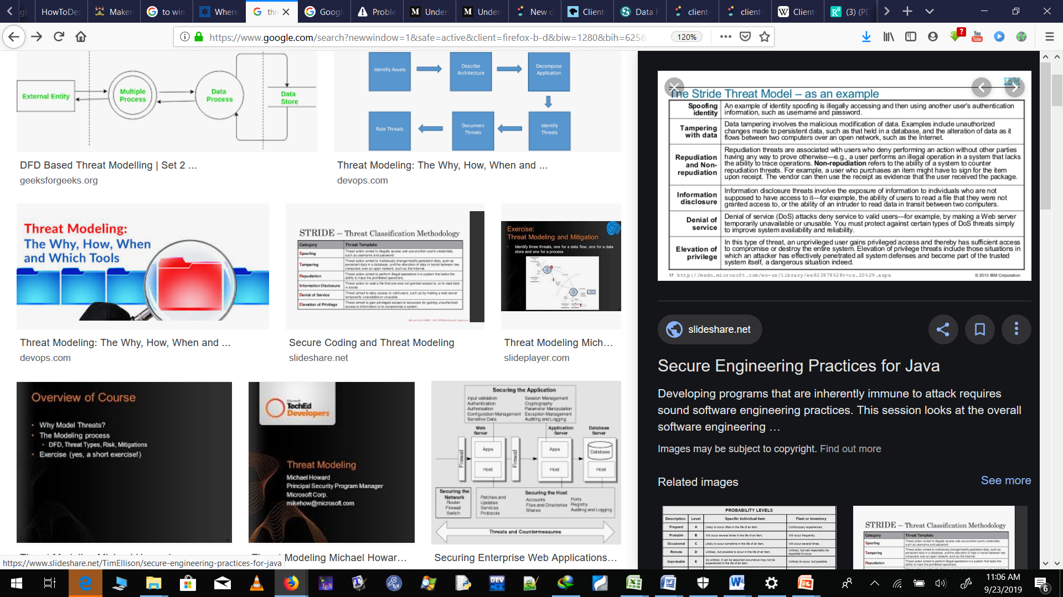

Slide 56
Step 5. Document the Threats
Miriam Celi, CISSP ~ 2017 SFISSA Security Conference
Document each threat using a common threat template that defines a core
set of attributes to capture for each threat:
Threat Description | Attacker obtains authentication credentials by monitoring the network
Threat target | Web application user authentication process
Risk Rating | TBD in Step 6
Attack techniques | Use of network monitoring software
Countermeasures | Use SSL to provide encrypted channel

Slide 57
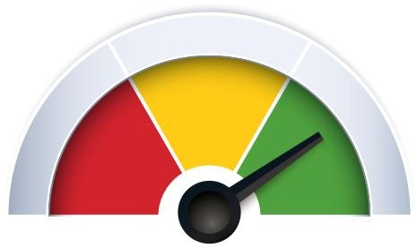
Step 6. Rate the Threats
Miriam Celi, CISSP ~ 2017 SFISSA Security Conference
Rate the threats to prioritize and address the most significant threats first. These threats present the biggest risk.
The rating process weighs the probability of the threat against damage that could result should an attack occur.
It may turn out that certain threats do not warrant any action when you
compare the risk posed by the threat with the resulting mitigation costs.
The DREAD model can be used to help calculate risk.

Slide 58
DREAD – Risk Ranking Methodology
<number>
After this STRIDE model, another model called DREAD model is applied to each identified threat. The DREAD model is a threat rating model and is used to assign threat severity and priority level of identified threats. The DREAD model stands for Damage potential, Reproducibility, Exploitability, Affected users and Discoverability.
When this process of threat rating by the DREAD model is completed, possible mitigation measures are recommended and listed in the next chapter
STRIDE approach is a manual process and does not have tool support.
From Security in Computing, Fifth Edition, by Charles P. Pfleeger, et al. (ISBN: 9780134085043). Copyright 2015 by Pearson Education, Inc. All rights reserved.

Slide 59
DREAD – Risk Ranking Methodology
Miriam Celi, CISSP ~ 2017 SFISSA Security Conference
With the DREAD model, you arrive at the risk rating for a given threat by
asking the following questions:
Damage potential: How great is the damage if the vulnerability is exploited?
Reproducibility: How easy is it to reproduce the attack?
Exploitability: How easy is it to launch an attack?
Affected users: As a rough percentage, how many users are affected?
Discoverability: How easy is it to find the vulnerability?
Risk = (Damage + Reproducibility + Exploitability + Affected Users + Discoverability) / 5

Slide 60
Rate the Threats cont’d
This way of assessing risk is too simplistic for some, so at Microsoft, the DREAD model is used to refine this calculation to add a dimension that assesses what the impact of a security threat really means.
Damage potential: How much damage can the threat inflict on the system?
Reproducibility: How difficult is it to reproduce the threat?
Exploitability: How easy is it for hackers to succeed in exploiting a vulnerability?
Affected users: How many users will be affected?
Discoverability: How difficult is it to discover the threat?

Slide 61
Rate the Threats cont’d
Applications and companies use different criteria for different elements of the DREAD model. The formula used to calculate the rank is not as important because the values derived are relative to one another. You just need to be consistent.
DREAD provides a further refinement of the simple
Risk = Damage * Chance formula.
D (Damage Potential) and A (Affected users) are analogous to Damage.
R (Reproducibility), E (Exploitability) and D (Discoverability) are analogous to Chance.
You can use this strategy to prioritize risks. After you calculate the priority for each identified security risk, you can prioritize the risks and determine a management strategy based on the priority value.

Slide 62
Rate the Threats cont’d
Within each DREAD category, use a score of 3 for high risk, 2 for medium risk, and 1 for low risk.
Assess each threat in your threat tree and assign the risk rating for each of the DREAD categories and add up the result.
For example, the SQL Injection threat identified earlier could have a score of D – 3, R – 3, E – 3 , A – 3, D – 2. This gives a total score of 14.
Across the total possible range of 5 – 15, 12 – 15 may be considered high risk, 8 – 11 as medium risk, and 5 – 7 as low risk.

Slide 63
Calculation of Risk (How does DREAD do this?)
Risk = Impact * Probability
Impact = (DREAD)
Damage
Note that Damage needs to be assessed in terms of Confidentiality, Integrity and Availability
Affected Users (how large is the user base affected?
Probability = (DREAD)
Reproducibility (how difficult to reproduce? Is it scriptable?)
Exploitability (how difficult to use the vulnerability to effect the attack?)
Discoverability (how difficult to find?)

Slide 64
Rating Threats
Simple model
DREAD model
Greater granularization of threat potential
Rates (prioritizes) each threat on scale of 1-15
Developed and widely used by Microsoft
Risk = Probability * Damage Potential
1-10 Scale
1 = Least probable
10 = Most probable
1-10 Scale
1 = Least damage
10 = Most damage
Notes:
113/12/03 15:34
© 2003-2004 Microsoft Corporation. All rights reserved.
This presentation is for informational purposes only. Microsoft makes no warranties, express or implied, in this summary.
<number>

Slide 65
Threat Modeling Process – Step 6: Rate/measure the Threats
Use formula:
Risk = Probability * Damage Potential
Use DREAD to rate threats
Damage potential
Reproducibility
Exploitability
Affected users
Discoverability
Notes:
<number>

Slide 66
Rate the Threats cont’d
At this step, you can fill in the risk data that you left blank in step 5.
After you document your threats, you need a way to determine which threats are the most dangerous. To do this, you need a way to rank them.
You can calculate risk using a 1-10 scale for probability (where 1 is not probable, 10 is very probable), and 1-10 for damage potential (1 – minimal damage, 10 – catastrophe). This results in a risk in the range of 1 – 100.
You can divide the scale into three bands to generate a High, Medium and Low risk rating.

Slide 67
Example 1 of DREAD Table
Miriam Celi, CISSP ~ 2017 SFISSA Security Conference
 | Rating | High (4-5) | Medium (2-3) | Low (1)
D | Damage potential | The attacker can subvert the security system; get full trust authorization; run as administrator; upload content. | Leaking sensitive information | Leaking trivial information
R | Reproducibility | The attack can be reproduced every time and does not require a timing window. | The attack can be reproduced, but only with a timing window and a particular race situation. | The attack is very difficult to reproduce, even with knowledge of the security hole.
E | Exploitability | A novice programmer could make the attack in a short time. | A skilled programmer could make the attack, then repeat the steps. | The attack requires an extremely skilled person and in-depth knowledge every time to exploit.
A | Affected users | All users, default configuration, key customers | Some users, non-default configuration | Very small percentage of users, obscure feature; affects anonymous users
D | Discoverability | Published information explains the attack. The vulnerability is found in the most commonly used feature and is very noticeable. | The vulnerability is in a seldom- used part of the product, and only a few users should come across it. It would take some thinking to see malicious use. | The bug is obscure, and it is unlikely that users will work out damage potential.

Slide 68
Example 2 of DREAD, Cont.
 | High (3) | Medium (2) | Low (1)
Damage potential | Attacker can retrieve extremely sensitive data and corrupt or destroy data | Attacker can retrieve sensitive data but do little else | Attacker can only retrieve data that has little or no potential for harm
Reproduc-ability | Works every time; does not require a timing window | Timing-dependent; works only within a time window | Rarely works
Exploitabilty | Bart Simpson could do it | Attacker must be somewhat knowledgeable and skilled | Attacker must be VERY knowledgeable and skilled
Affected users | Most or all users | Some users | Few if any users
Discoverabilty | Attacker can easily discover the vulnerability | Attacker might discover the vulnerability | Attacker will have to dig to discover the vulnerability
Notes:
113/12/03 15:34
© 2003-2004 Microsoft Corporation. All rights reserved.
This presentation is for informational purposes only. Microsoft makes no warranties, express or implied, in this summary.
<number>

Slide 69
Example
Threat | D | R | E | A | D | Sum
Auth cookie theft (eavesdropping) | 3 | 2 | 3 | 2 | 3 | 13
Auth cookie theft (XSS) | 3 | 2 | 2 | 2 | 3 | 12
Potential for damage is high
(spoofed identities, etc.)
Cookie can be stolen any time, but is only useful until expired
Anybody can run a packet sniffer; XSS attacks require moderate skill
Prioritized
Risks
All users could be affected, but in reality most won't click malicious links
Easy to discover: just type a <script> block into a field
Notes:
113/12/03 15:34
© 2003-2004 Microsoft Corporation. All rights reserved.
This presentation is for informational purposes only. Microsoft makes no warranties, express or implied, in this summary.
<number>

Slide 70
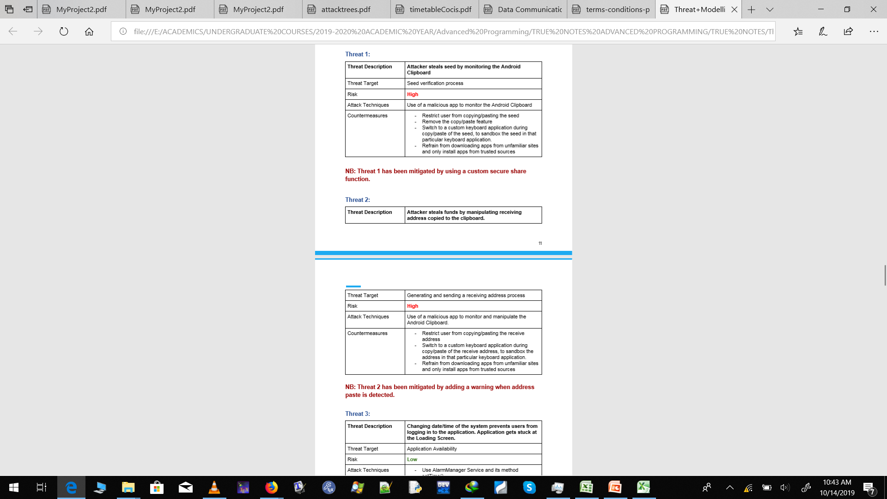

Slide 72
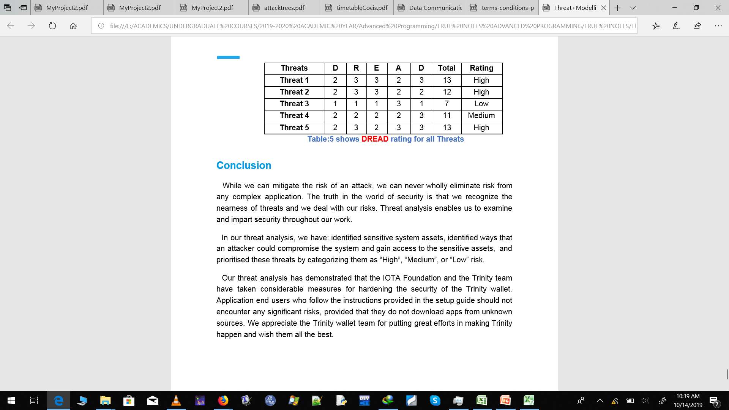
DREAD MODEL

Slide 73
Calculation of Risk (Cont’d)
Let’s establish a few assumptions
In the Risk equation; Damage and Probability are equally important
The factors, as well as the result should have mathematical value (in order to assist in easily determining priorities)
Therefore in any formula giving each factor equal weight an imbalance occurs giving Probability a 3:2 representation over Damage
To mitigate:
e.g. Risk = Impact(D+A) * Probability(R+E+D)
while ensuring the summary of qualitative scales for Risk and Probability are equal (e.g. D+A=(1-10) & R+E+D=(1-10) which results in a scale of 6-100 when the summation of factors are multiplied

